Slide 1

Stocks and Housing: How Local Can We Get?
Casey Hill
Sean Lane
Grace Hsu
UCB Extensions: Data Analytics Bootcamp Project 1 (Jan 14, 2019)

Slide 2
Hypothesis
Can a company’s stock value influence their headquarters housing market?

Slide 3
Questions
Is a company’s stock price and their headquarters housing market correlated during years 2005 to 2015?
What correlation can we find between our hypothesis and the sub-categories of the companies? (Industrial/Tech, Finance, Retail, Other)
If there is a correlation between stock and housing prices, what level of change can be expected from this single variable?

Slide 4
Data Mining Summary

Slide 5
Data Exploration and Cleanup

Slide 6
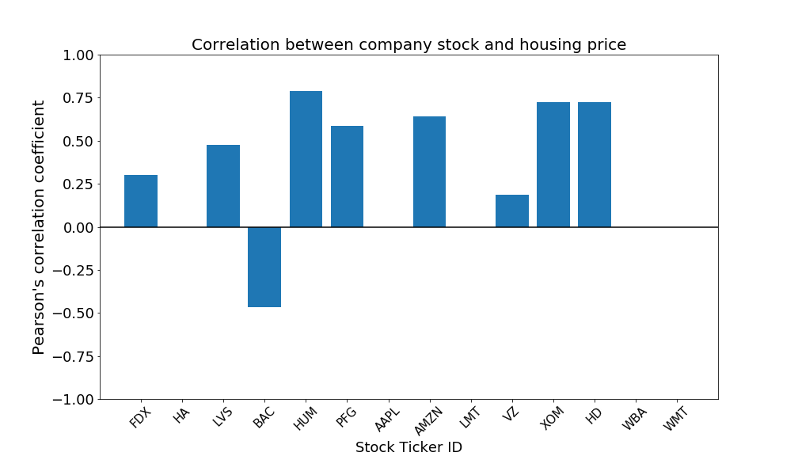
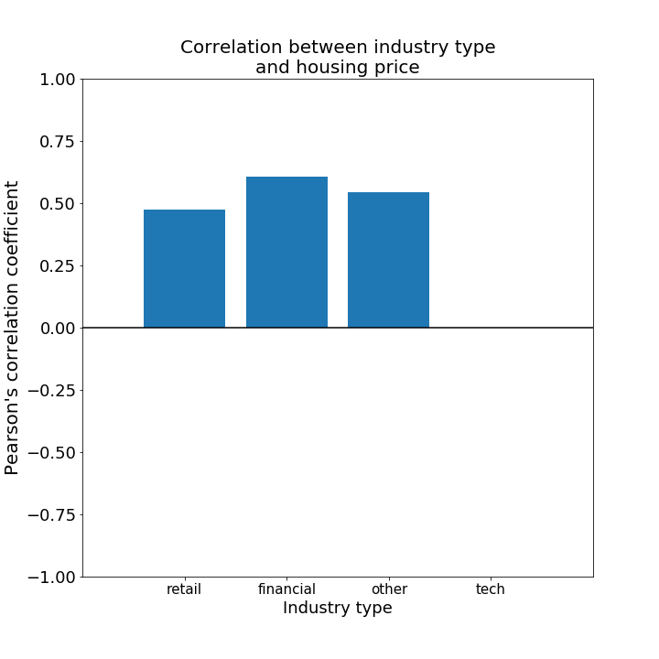
Analysis

Slide 7
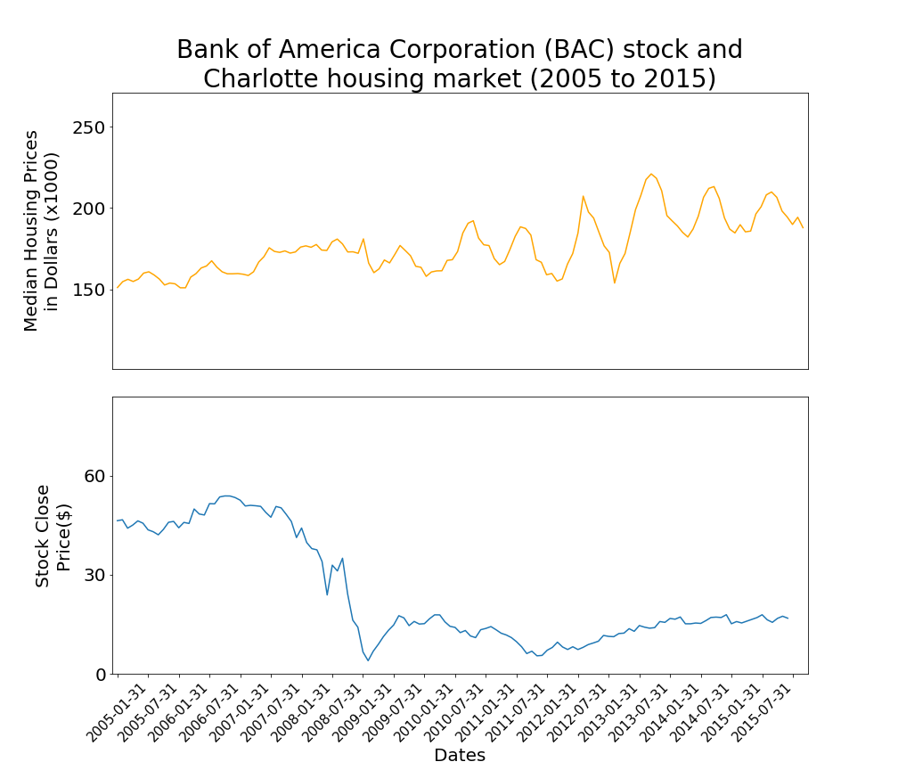
The Financial Crash of 2008-2009
Pearson r : -0.465546108
P Value : 1.86E-08

Slide 8
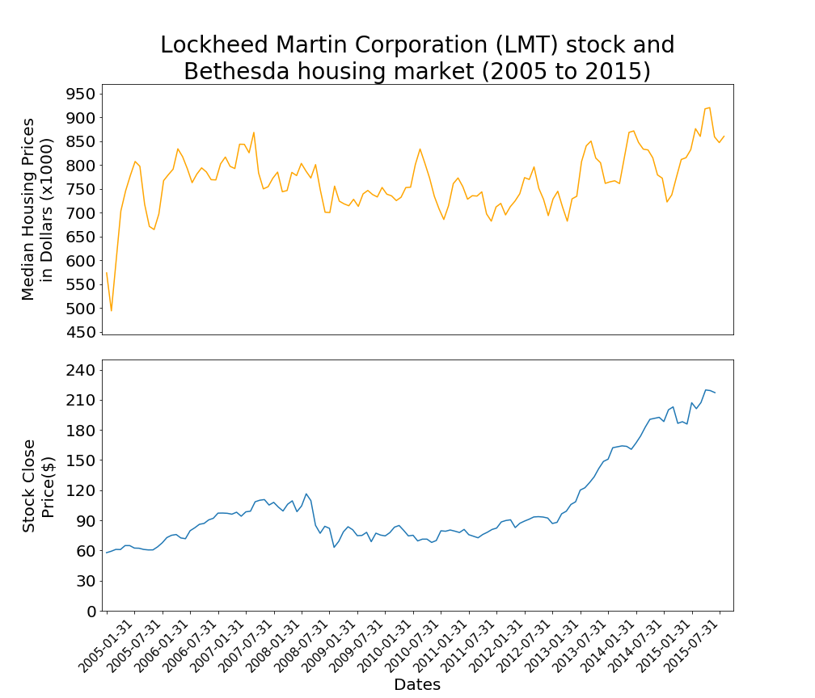
The median household income in North Bethesda, MD is nearly 2x the US average. ($103,000)
Pearson r : 0
P Value : 1

Slide 9
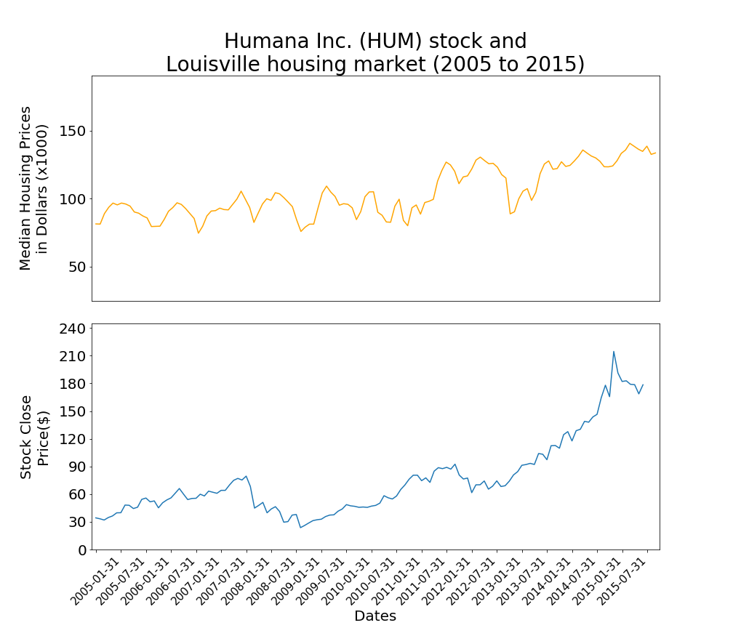
Humana is the 2nd largest employer in Louisville, KY. (9,854)
Pearson r : 0.78985244
P Value : 2.20E-29

Slide 10
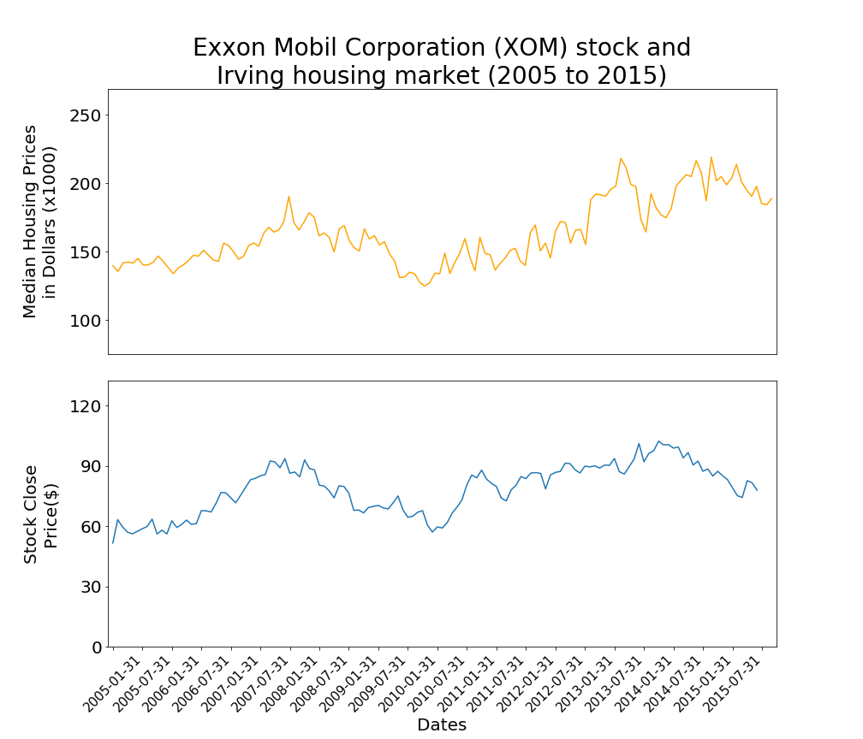
Exxon Mobile is the 9th largest company by revenue
Pearson r : 0.723121846
P Value : 1.23E-22

Slide 11
Conclusions
Low Median Household income has the largest impact on correlation
If the city has a low household income, a companies success determines the economic value of the city
City Population affects the correlation of stock and housing, but not to the extent of Household income
High population shows a lower correlation factor, but to only a degree of effectiveness – NYC is an exception due to the difference in population to other samples
Industry Type has an effect on correlation
Financial organizations tend to have a higher correlating factor than Tech or Retail
Headquarters may have higher percentage of company population
Retail – employee population spread throughout country
Tech – employees have higher income than other industries

Slide 12
Implications
For Companies
The search for a new headquarters can factor the population size and household income along with any other factors
Lower household income = more incentive from a city to build inside their limits
Lower population = Less of a workforce to pull capable employees
For Cities
There are new factors to look for when bringing a company into your city limits
Company Stability: If your household income is low, the success of the company will dictate the success of your city economically.
Company growth = city growth; BUT
Company losses = city losses
Population size: Mitigate the impact of the company with a higher population size.

